Slide 1
Assignment Course Project Shiny Application and Reproducible Pitch Chenggong 6/19/2016

Slide 2
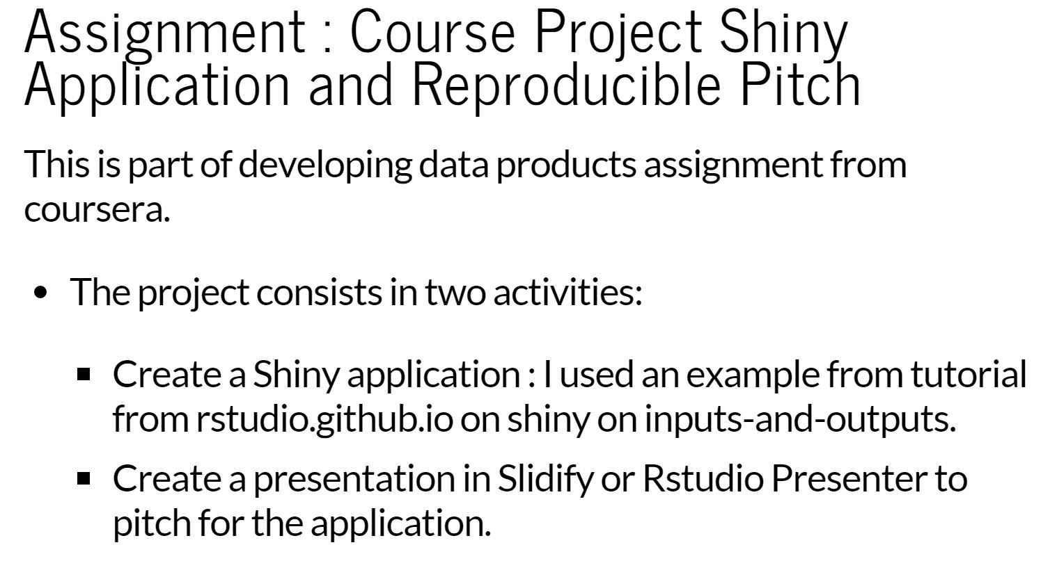

Slide 3
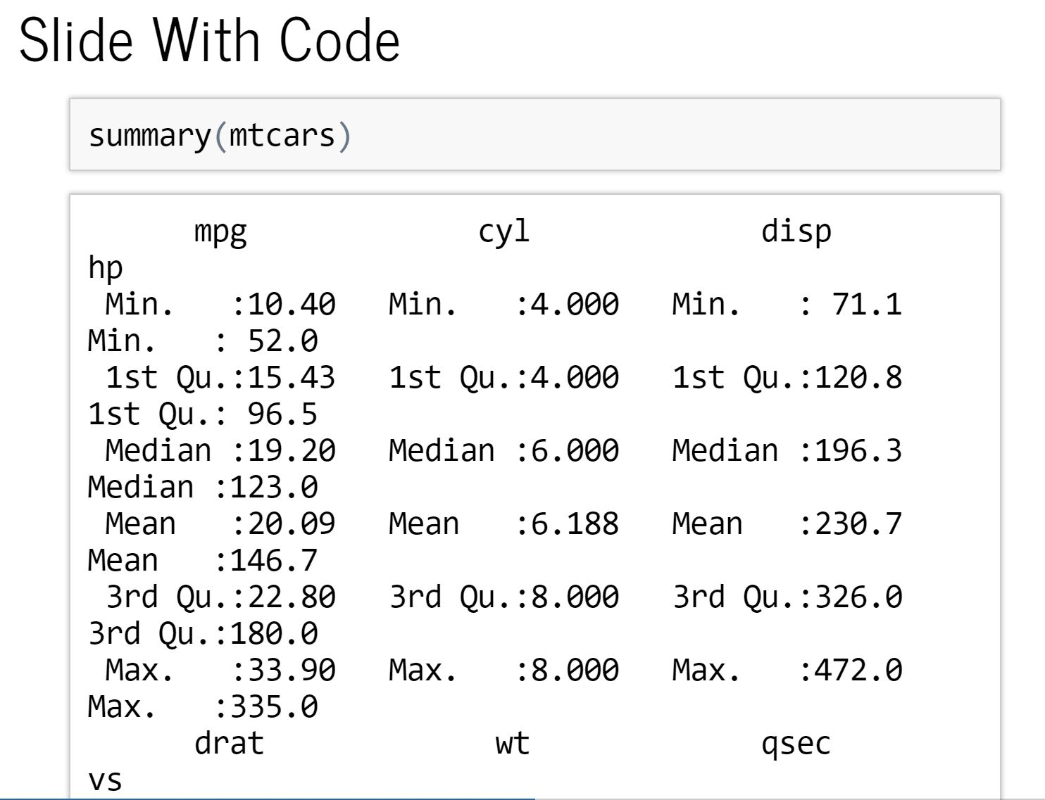

Slide 4
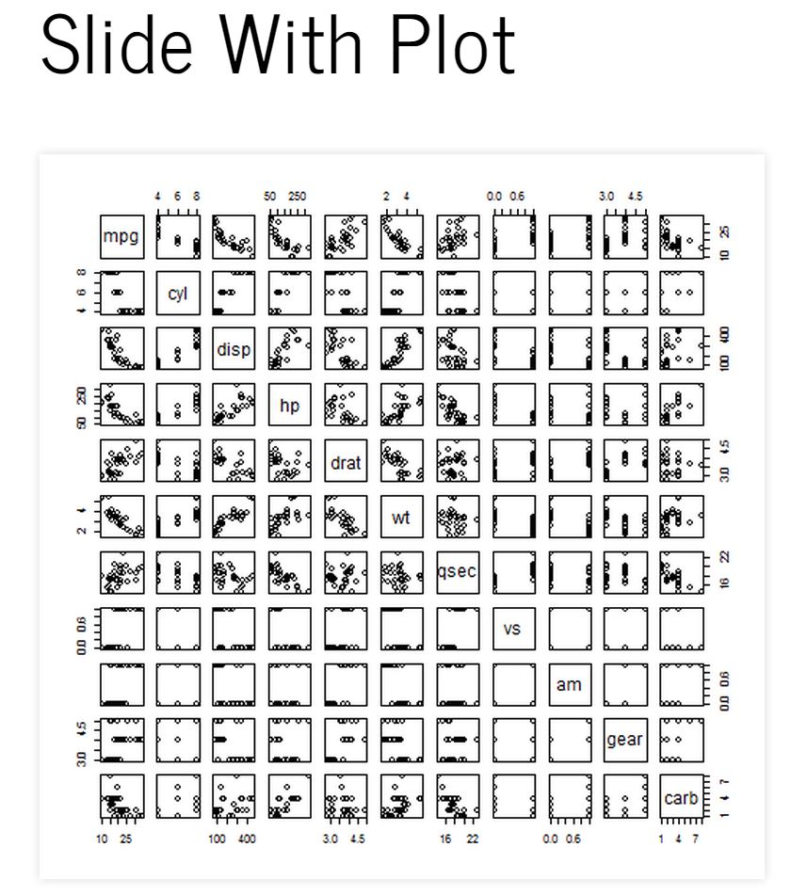

Slide 5
